Slide 1
Topic Modelling
Atul Mohan

Slide 2

Use Case
Document Identifiers
Meta Information
Author
Date
Publication ….
Information categorized based on some criteria.
Time Criteria
Author Criteria
Keyword Criteria
Topic Criteria

Slide 3
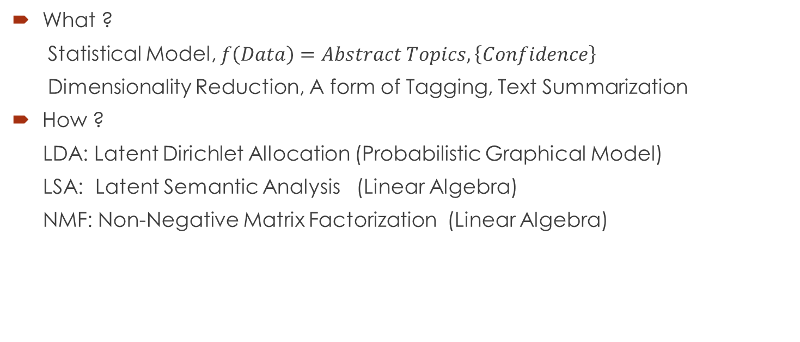
Topic Modelling
What ?
Statistical Model, $f\left(Data\right)=Abstract Topics, \left\{Confidence\right\}$
Dimensionality Reduction, A form of Tagging, Text Summarization
How ?
LDA: Latent Dirichlet Allocation (Probabilistic Graphical Model)
LSA: Latent Semantic Analysis (Linear Algebra)
NMF: Non-Negative Matrix Factorization (Linear Algebra)

Slide 4
Topic Modelling
Steps:
Acquire Data
Clean Data: Tokenize, Stopwords, Stem & Lemm
Word Dictionary: Doc2BOW, TFIDF
LDA Algorithm
Visualize Information
Understanding the results.
DEMO

Slide 5
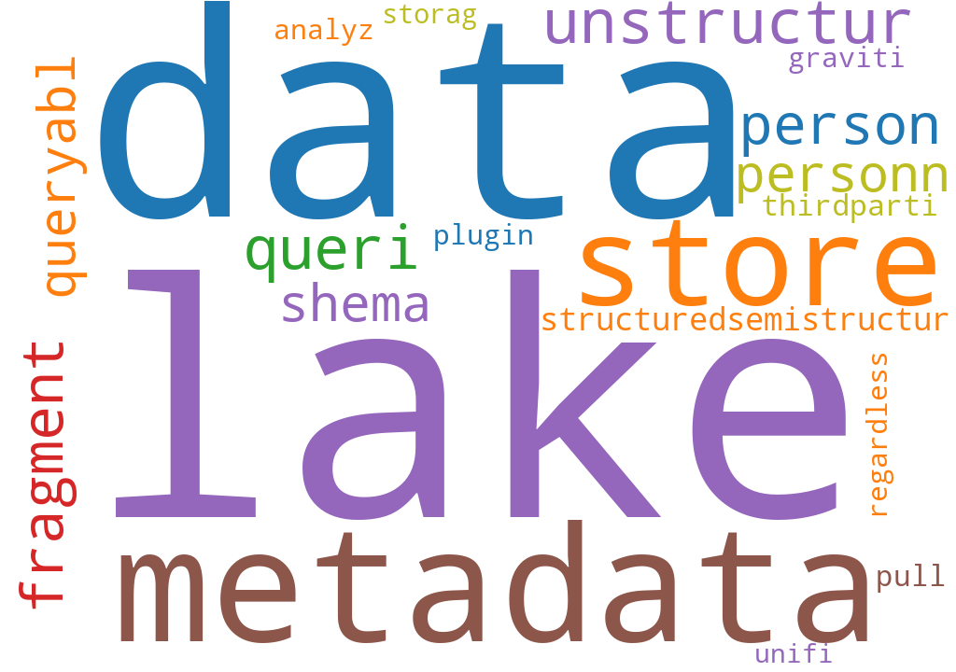
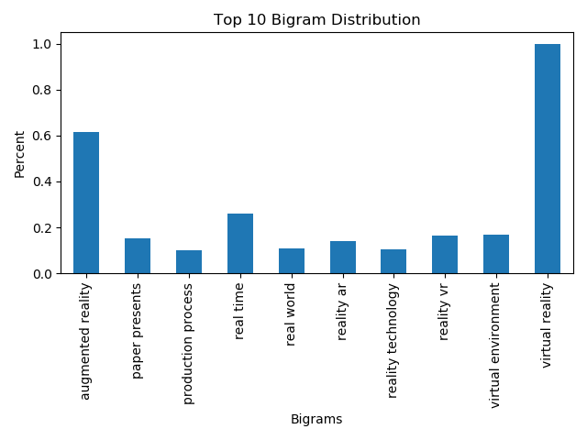
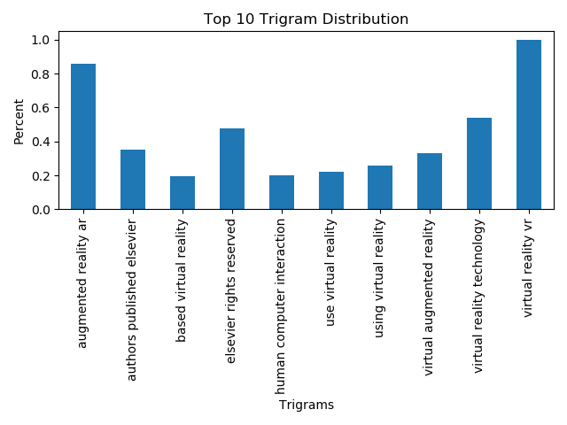
Topic Modelling
Understanding Results
Topic Visualization: Topics, Keyword Association, Dominant Keywords / Topic
Bigrams & Trigrams
Word Clouds

